Slide 1
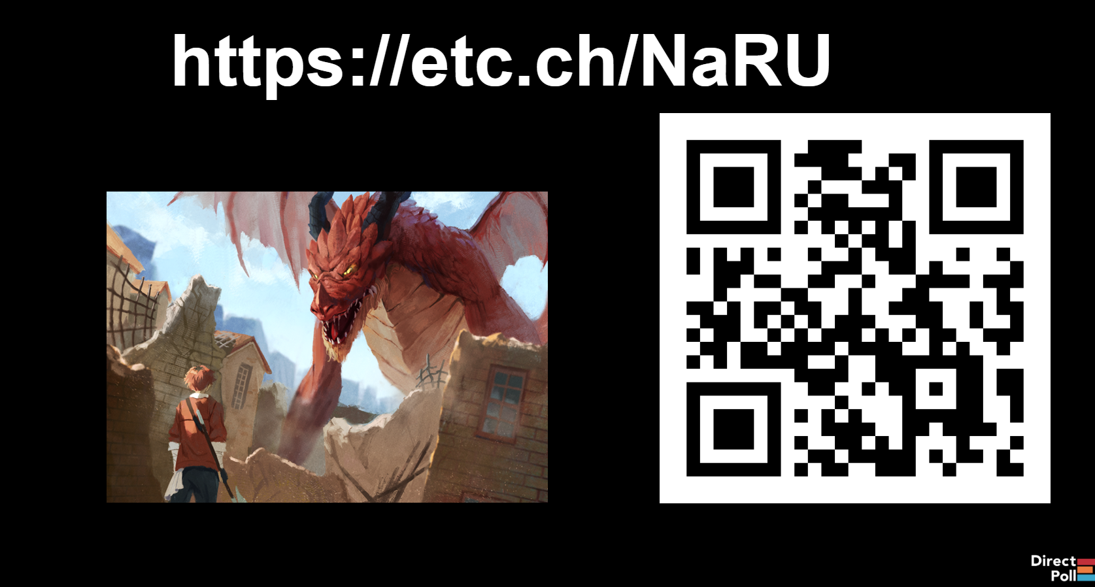
DUNGEON DILEMMAS
AMKE
2026
DUNGEON
DILEMMAS
AMKE 2026

Slide 2
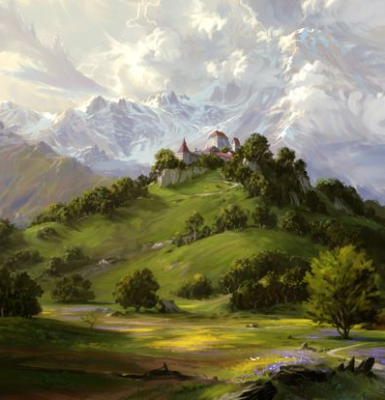
Intro: Dear Gods, What Are They Doing to My Helpful NPC?!?
You’ve carefully crafted a fun, multi-session mission for your adventuring party! There will be unknown wilds to explore; fearful monsters to be faced; puzzles to be solved; treasure to be found; villages to be saved. At the outset of the first session, the party finds themselves on the open road. With adventure ahead, a friendly old man approaches from up the path. He greets them warmly and prepares to offer them guidance to nearby ruins full of treasure when…
… the rogue tries to sneak attack him with a blunt object to the cranium, the wizard shouts “FIREBALL!” despite not knowing that spell yet, and the barbarian sees if they can pick the old guy up and punt him into the treeline. *sigh*… roll initiative. What do you do next?

Slide 3

Intro: Dear Gods, What Are They Doing to My Helpful NPC?!?
The party attacks your poor old helpful guide. What now?
Turns out the friendly old man was a retired high-level adventurer! Time to knock heads.
Play the scenario without changing anything you’d prepared ahead of time. The gentle old guide suffers tremendous head trauma and may never recover.
Nearby guards hear the commotion and join to stop the party. Next session will involve a trial, and/or jailbreak.
I’m so sick and tired of this!!! Rocks fall, everyone dies.
Other __________________________________
https://etc.ch/NaRU

Slide 4
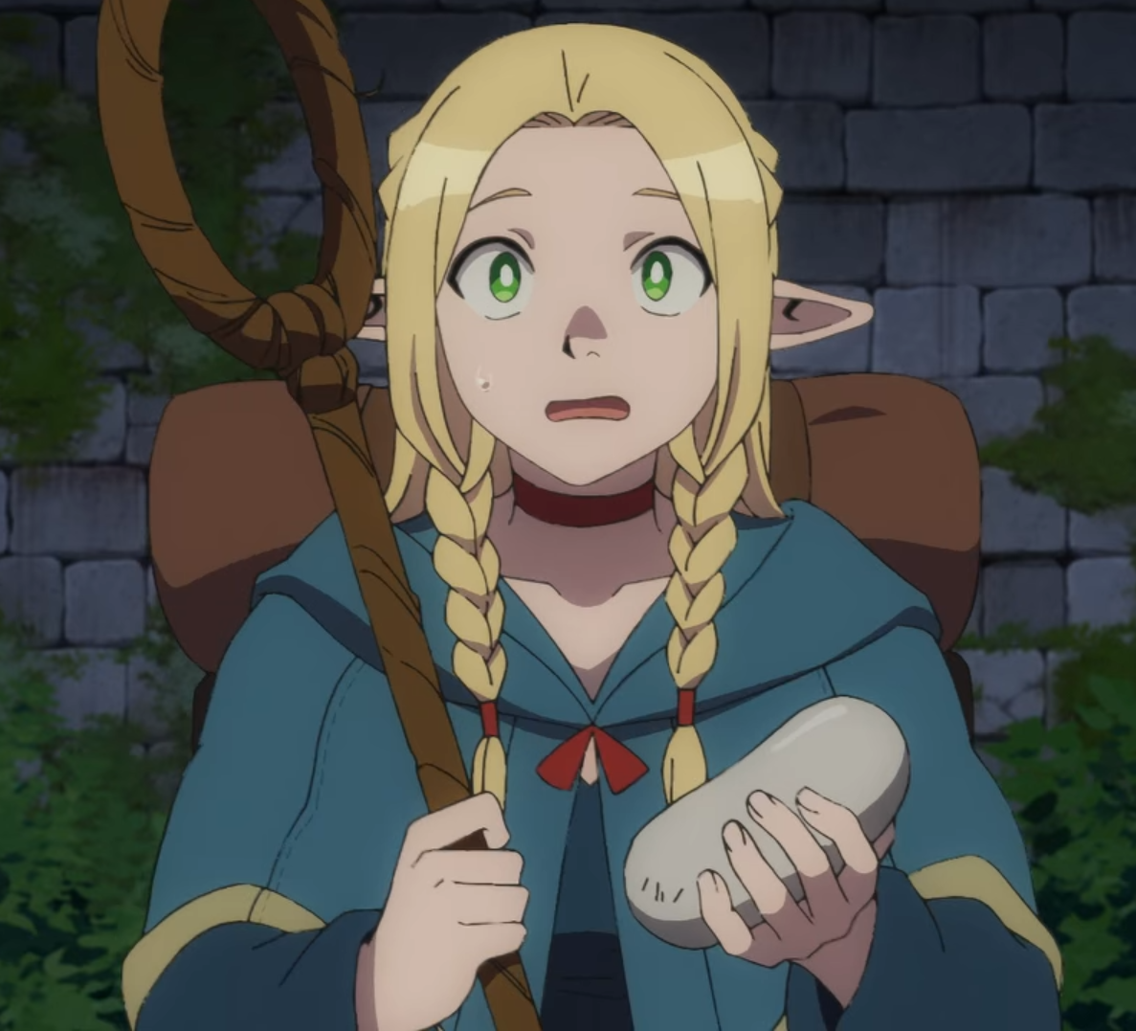
Panel Outline
Panel presenter intro & background (1 minute)
Companion event: Learn-to-DM tomorrow! (1 minute preview)
The importance of Session Zero (5-8 minutes)
What makes a good DM? (8-10 minutes, including discussion)
Dungeon Dilemmas! (~5-10 minutes per scenario with live polling and discussion; discuss dilemmas until last 5 minutes)
Q&A and conclusion (last 5 minutes)

Slide 5
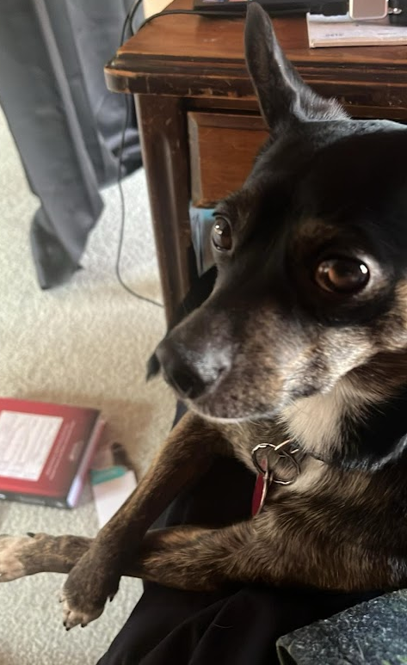
Panel presenter intro & background
Welcome to Dungeon Dilemmas! I’m Nick & that’s Temo
Shorewood native, MPS teacher 2009-2019; current data scientist
Running D&D campaigns for 17 years in 3.5e and 5e, including:
-6 completed campaigns ranging from 3 months to 6+ years
-1 campaign currently in progress
-8 current & former players who run their own games
Panel goal: facilitate discussion & empower attendees to run their own games, improve an existing game, be more mindful RPG players/DMs, and keep games alive!
Cuauhtémoc helps work from home

Slide 6
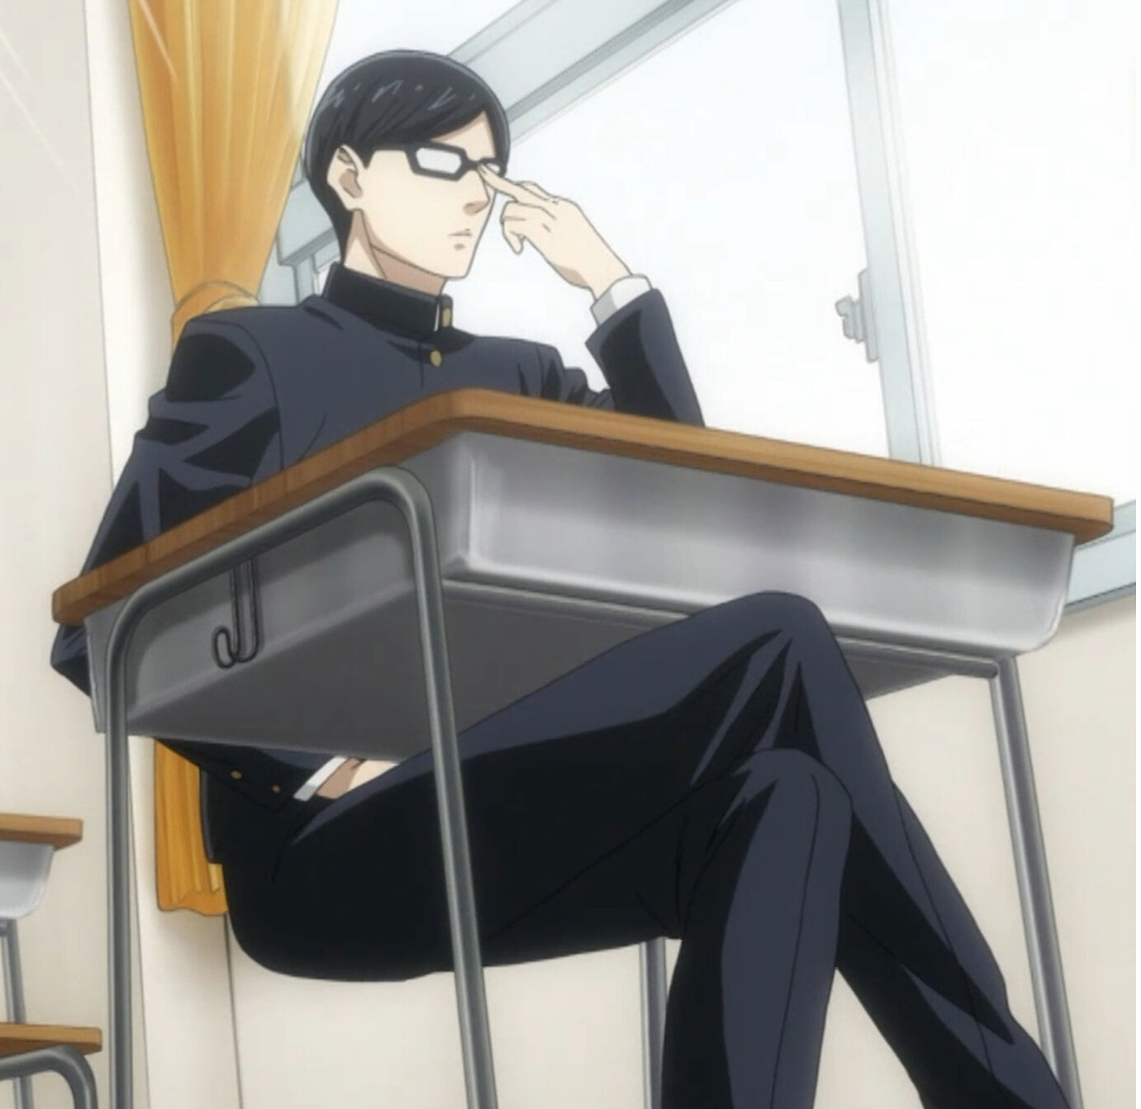
New in 2026: Learn to DM!
Tomorrow (Saturday, March 7) 1-4 PM in the Tabletop Gaming Room
12 slots (3 tables of 4 new DMs each)
Premade oneshot (materials provided)
Run an encounter - combat, RP, or both - with other table participants (plus facilitator) serving as test players
Get feedback from participants right afterward: identify strengths & areas for growth!
Signup opens after this panel

Slide 7
The Importance of Session Zero
Prevention is the best medicine!
Session 0: setting expectations & planning HOW you will play as a group BEFORE you actually play!
Many excellent resources already exist, top Google & YouTube results are all solid. My materials at dungeondilemmas.com
4 key points: Purpose, Setting, Logistics, and Shared expectations
Purpose?
Setting?
Logistics?
Shared
expectations?

Slide 8
Session Zero: Examples
I) Purpose: What brings us to the game? What do we want to get out of playing? (Ex: RP, combat, exploration, storytelling, puzzles…)
II) Setting: Where/When/How/What/Why?
General setting (classical fantasy, low magic, steampunk, sci-fi, modern, historical fiction, horror, existing IP/world, soulslike, etc…)
Scope (from narrow (eg one village/city) to broad (eg entire continent, world, galaxy)
Existing level of conflict (peaceful – wartorn, 1-10)
Pantheon/religion in-world?
III) Characters & Player logistics: How do we know one another & interact, in & out of game?
Out of game: What constitutes enough players to proceed if someone can’t make it?
In-game: Do the player-characters know one another, or will that be established in-game?
Backstories: Do you want to create part/all of your backstory ahead of time, or create as you go?

Slide 9
Session Zero: Examples
DM - Player | Player - DM | Player - Player
-Conflict & disagreement within the party fuels some of the most interesting parts of a D&D story. However, try to avoid actively sabotaging / attacking / targeting one another! (See rule #2 under Player-Player expectations) -Be present during a session: everyone will have moments when they need to check phones, take care of something, or step out; we’re all adults. In general respect your fellow players & DM | -Create a constructive, interactive story that everyone can be a part of -Go with the flow: don’t be upset with player decisions. Adapt & be flexible in the moment! -Allow choice: don’t railroad the players!! D&D becomes much less fun when players feel that they have no agency or that they are just doing something because the DM said they needed to | - “Have fun, go nuts” :D - “Don’t be an a**hole” XD -Try to be a team. Avoid story-derailing decisions or decisions that will massively impact the entire party without consulting with one another first -Keeping the above in mind: think about how you roleplay different alignments within a party. (DM note: parties with a mix of good/neutral/evil or lawful/neutral/chaotic CAN work, but it requires thoughtful roleplaying!)

Slide 10

What Makes a Good DM?
Challenge?
Conflict Resolution?
Game Knowledge?
Improvisation?
Logistics?
Roleplaying?
Worldbuilding?
Other?
https://etc.ch/NaRU

Slide 11
What Makes a Good DM?
In my opinion…
IMPROVISATION
>>>>>>>>
all other characteristics!!
MINDSET SHIFT: “I have a story to tell…” → “WE have a story to tell!!”

Slide 12
What Makes a Good DM?
Worldbuilding Narrative Geography Peoples
Game knowledge Mechanics Interactions When to modify rules
Conflict resolution Player-Player Player-DM Outside world
Logistics Planning Scheduling Creating positive spaces
Improvisation Shared storytelling Adapting to player choice “Rolling” with the dice
Roleplaying Allies Antagonists Other NPCs
Challenge Mission & Purpose Encounters Puzzles

Slide 13
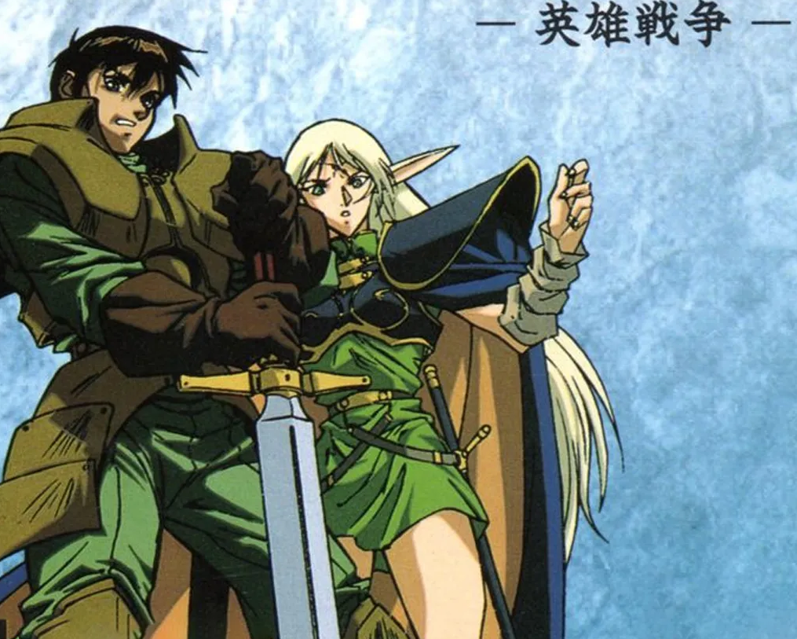
Dungeon Dilemmas
DILEMMA TIME!!!!!
For each scenario:
Situation
Vote
Discuss!

Slide 14
Dilemma 1: What are we supposed to do?
You know you don’t want to be the type of DM who “railroads” your players – forces them down a preconceived storyline. In session 0 the players requested as much freedom of choice as possible. Now here we are in session 1. You’ve set the scene: a gloomy town, suffocating from generations of unspoken secrets. Townsfolk walk with eyes downcast; the guards skitter by on their patrols; and you narrate a series of plot breadcrumbs for the party to follow. You’re prepared for the party to follow any of these threads, but as soon as you turn things over to the players you’re greeted with:
“What do we do?”
“Can we get better gear right away?”
“Can you repeat what you said about the different stuff in town?”
“Wait, what are we doing?”
“What are we supposed to do?”

Slide 15
Dilemma 1: What are we supposed to do?
a) Provide a brief recap of all the breadcrumbs as requested and ask the group if anyone wants more info. As you feel out which scenarios captivate their attention, nudge them in that direction.
b) Give it time. Let player ideas marinate; let them experience a bit of friction or even discomfort as they work through their options. Once they choose a route, they’ll be even more invested.
c) If the players seem truly gripped by analysis paralysis, make an executive decision and pick your favorite or best-prepared scenario. Pick for them, while giving them choice in how they execute it.
d) Force the party into action by having a monster attack in broad daylight. After the battle, link the attack to one or more of your breadcrumbs.
e) Other _____________________________
https://etc.ch/NaRU

Slide 16
Dilemma 2: Is this your character, or Chat GPT?
As you progress through your campaign, you notice one player in particular who seems to have particularly quick responses to your puzzles. When roleplaying they often sound like they’re reading off a script. One day they reveal that they like using Chat GPT for pretty much everything in game – character creation, solving puzzles or intrigue scenarios that the DM gives to the group, and even speaking for their character. The other players seem to have mixed reactions. Some say that they also use GPT or other tools to help come up with character art and background ideas. Others say they’d like to try solving the puzzles and learning about the world themselves.
As a DM, how do you feel about this in your game?

Slide 17
Dilemma 2: Is this your character, or Chat GPT?
It is not my job to police how others approach the game. If some want to use AI tools, so be it; if others prefer not to, they do not need to.
AI impacts the experience, since one or more players prefer not to have puzzles trivialized by AI. Ask the GPT-using player if they’d be comfortable dialing back their use in cases like this.
Revisit session 0 and have an open discussion with the group on AI. Why do we all enjoy tabletop RPGs? How can AI tools help create more positive experiences, and how can they potentially create harmful experiences?
Mwahahaha, you fools…I’ve been AI all along!!!
Other_______________________________________________
https://etc.ch/NaRU

Slide 18
Dilemma 3: Unequal spotlight
You’ve been playing with a new group and things seem to be going well. After the first few sessions, everyone seems to be getting more comfortable telling stories in your shared world. However, things are starting to feel unbalanced. One player tries to take the lead in every conversation with NPCs, arguing that they have the best stats for it. Another player constantly tries to find plot hooks for their backstory, and seems impatient when you offer breadcrumbs to other player-characters. And one player seems fairly quiet and does not speak up nearly as much as everyone else. In private, this player has shared that they would like to be more involved but feel overwhelmed when more experienced players jump into dialogue with NPCs so quickly. Worried about the group dynamic, you try to prioritize which player situation to address first – what do you do next?

Slide 19
Dilemma 3: Unequal spotlight
a) Offer a solid plot hook to the quiet player OR the vocal player, but set it up so that they will need specialized help from each of their party members. At the conclusion of their plot hook, lead into another character’s backstory.
b) Encourage the player who always takes the lead in NPC conversations to allow other characters to engage. Try to regularly offer information without dice-based checks to show the players that anyone can build the shared story without worrying about bad dice.
c) Create roleplay situations where NPCs directly address different members of the group at different times, ensuring everyone is involved. If player-characters try to talk over one another, gently but firmly re-ask the question to the original player.
d) Give a “compliment/constructive criticism/compliment” sandwich to one or both of your most active players, in private. Thank them for their great spirit and engagement, while asking for their help in bringing out more participation from other players.
e) Other _____________________________
https://etc.ch/NaRU

Slide 20
Quick Vote: Next Dilemma(s)?
Cultural Appropriation vs Cultural Appreciation
Scheduling issues
Uncomfortable player behavior
Players’ unexpected actions make you run out of prepped material
Everyone is on their phones
Real world problems spilling over into the game
How to challenge high-level players

Slide 21
Dilemma 4: Cultural Appropriation, or Cultural Appreciation?
After session 0, one of your players approaches you with a character concept. As you read about their traits and backstory, you quickly notice that this character is overflowing with stereotypes that apply to a specific group of people who exist in our world (Earth, 2026). The player is not a member of this group, nor do they know anyone who is. You neutrally ask, “where did your inspiration for this character come from?” – and the player answers that they just think it would “be more realistic,” and that it’s “inspired by what’s actually real.” As a DM, how do you handle this character concept?

Slide 22
Dilemma 4: Cultural Appropriation, or Cultural Appreciation?
Ask that the player create a character who is not based on real-world stereotypes. Roleplaying games can draw from real world inspiration, but in this case it seems overwhelmingly negative.
Remove the player from the group, as this could be a serious red flag for things to come and attempting to engage in dialogue would only drain you
Encourage the player to learn more about the group that they’re using for character inspiration, and rework some of the key traits and background based on a more complete understanding.
Allow the player to bring their horribly stereotyped character into the campaign, then kill their character mercilessly at the first possible opportunity.
Other________________________________________________
https://etc.ch/NaRU

Slide 23
Dilemma 5: We just can’t seem to schedule a session
The final boss of gaming: scheduling. Your group just can’t seem to find a date and time that works for everyone’s schedule. On the rare occasion that you agree, something always seems to come up for someone at the last minute. The campaign is losing steam and you fear it may come to an unjustly early end. What do you do next?

Slide 24
Dilemma 5: We just can’t seem to schedule a session
https://etc.ch/NaRU
a) See if everyone can agree to play when down one or more people. Existing players could handle more than one player-character, absent players could be sent on side missions, or they could simply rest.
b) All good things must come to an end. Life brings us together and life brings us apart; if this campaign’s time has come to a close, celebrate its joys and prepare for your next journey.
c) For those who can make it, have a board game night! Maintaining a regular cadence will encourage people to keep that spot in their calendars open, and when the stars align again, your campaign may continue.
d) It can hurt when the hard work and thought you put into your campaign goes to waste because of scheduling troubles, or if you were excited for the next part of your character’s story and suddenly everyone cancels. Reach out to your players individually or as a group and express the joy you get from spending time together, sadness at missing out on these adventures, and genuine hope of restarting the campaign. Try to avoid expressing frustration or annoyance, as we never know the outside circumstances others face.
e) Other _____________________________

Slide 25
Dilemma 6: They’re making me uncomfortable…
Your players are digging deeper into your campaign, uncovering new plot threads and making interesting new choices. This is mostly great! – except one player seems to always want to create romantic encounters, even when inappropriate for the context. At first the whole group laughed this off, thinking it was a joke; it soon becomes clear that it isn’t. This session, the player has their character make an inappropriate comment to another player-character. The targeted player asks them to stop before you can intervene; the session ends not too long after, with tensions rising. What do you do next?

Slide 26
Dilemma 6: They’re making me uncomfortable…
https://etc.ch/NaRU
a) Meet as a whole group to discuss these types of interactions before the next session. If this wasn’t explicitly discussed in your Session 0, it could be time to do so now.
b) Check in with the player who made the inappropriate comment and remind them about your shared expectations for the table. Ask that they apologize to the other party before the next session.
c) Ask the problem player to leave the group. No one should be invading your table’s space with words or actions that make others uncomfortable.
d) Kill the problem player’s character with extreme prejudice at the start of the next session.
e) Other _____________________________

Slide 27
Dilemma 7: I never thought my players would do THAT!??!
Your players have been on a hot streak for the last few sessions – they’re roleplaying like never before, making intelligent tactical decisions, and taking your shared narrative in new and interesting directions. Maybe a little TOO interesting?? You had planned a maze-like challenge to last this whole session, but through some clever maneuvers you hadn’t taken into consideration, your players have totally trivialized your setup and all the encounters it contained. After speedrunning to the end, everyone sips their drinks, crunches on their snacks, and looks to you – with two and a half hours left in today’s session! With nothing planned, what do you do next?

Slide 28
Dilemma 7: I never thought my players would do THAT!??!
https://etc.ch/NaRU
a) Frantically Google or dig through sourcebooks for a new encounter that vaguely fits the current setting and throw it at your players to give them something to chew on while you regroup!
b) Compliment your players on their sharp moves, reward them with all the originally planned rewards from the session, and tell them honestly that you were unprepared for this! Take out a board/card game or see if everyone wants to watch a movie. It’s OK to ask for time and come back next session.
c) Tell the players they perceive sights and/or sounds of another group traversing the gauntlet they avoided – and this new group seems to be uncovering hidden treasure by taking their time. A rival emerges – will the party go back in to investigate? If not, you could send the new group after the party.
d) If the players skipped over certain encounters in your plan, they have no way of knowing what exactly those encounters contained. Wherever the players go next, repurpose those skipped encounters to appear in that new setting.
e) Other _____________________________

Slide 29
Dilemma 8: Everyone is on their phones
You arrived at this week’s session well prepared, with plenty of interesting options for the players to explore. About thirty minutes into the session, you start to notice people’s attention slipping. When their character isn’t actively engaged in role-play, several of your players start scrolling their phones. During longer combat encounters, players lose focus when it isn’t their turn to act. Sometimes they miss key pieces of information and you or another player must repeat themselves; sometimes they are put on the spot and are unprepared due to their split attention. How do you get the group back together?

Slide 30
Dilemma 8: Everyone is on their phones
a) Avoid splitting the party as much as possible. Distractions often worsen when the viewpoint switches between groups. If this means putting your players on a bit of a railroad, then all aboard the train. Choo choo!
b) If combat encounters are bogging the party down, institute a turn timer for both you and your players. If actions aren’t decided by the end of the timer, that’s that!
c) Leave things as they are and push on. The natural ebb and flow of any table means that sometimes players will be more distracted, and sometimes they will be more engaged. Let them return to focus on their own
d) Propose a collective deposit of phones at the start of the night, plus one or more breaks to let everyone regroup throughout the session.
e) Other _____________________________
https://etc.ch/NaRU

Slide 31
Dilemma 9: Real world problems
Outside of the game, two of your players have a serious falling out. You aren’t sure of the circumstances, but both tell you they will not be attending the next session. No one else was there for whatever caused the falling out, and at this point it seems like one or both may want to drop out of the campaign. How do you proceed? This is a two-part dilemma: A and B form part one, while C and D form part two.

Slide 32
Dilemma 9: Real world problems
a) Enlist the help of your other players in discovering what happened and what – if anything – can be done to fix it.
b) Talk to both players individually and try to determine what occurred. If possible, mediate a reconciliation; if not, another dilemma faces you in what to do next.
c) Other _____________________________
AFTER FIRST DECISION
a) See if the players can come to an agreement about continuing the campaign together, or with just one remaining. If they cannot agree, randomize who remains.
b) Make an executive decision on who will continue in the campaign based on your understanding of what caused the falling out. They can choose to follow your decision, or not.
c) Other _____________________________
https://etc.ch/NaRU

Slide 33
Dilemma 10: How to challenge godslayers?
We’ll call this one of those good problems: your adventuring party has been together for years, conquered countless challenges, and reached the near-pinnacle of character power. From slaying low-level zombies to facing off against world-killing threats, they’ve completed a true hero’s journey. So… what now??

Slide 34
Dilemma 10: How to challenge godslayers?
a) Take them to a new plane of existence and create your own post-endgame content! If world-killing threats aren’t enough, how about multiplanar/multiversal threats?
b) All stories end one day, and this party’s story has reached its natural conclusion. Time to take a little hiatus and plan your next campaign!
c) If the party isn’t ready to leave these characters behind, what about a prequel campaign? Or a campaign based on beloved side characters, or important people from the party’s backstories?
d) Allow the party to narrate the end of their own journey. Have a session where they write or narrate their own epilogues and share them with the group. Afterwards, vote on where to go from here.
e) Other ____________________________________
https://etc.ch/NaRU

Slide 35

Q & A
Thanks for participating!
Info from this presentation at dungeondilemmas.com
Continue the discussion at reddit.com/r/dungeondilemmas

Slide 36



Slide 37
2025 ARCHIVE

Slide 38
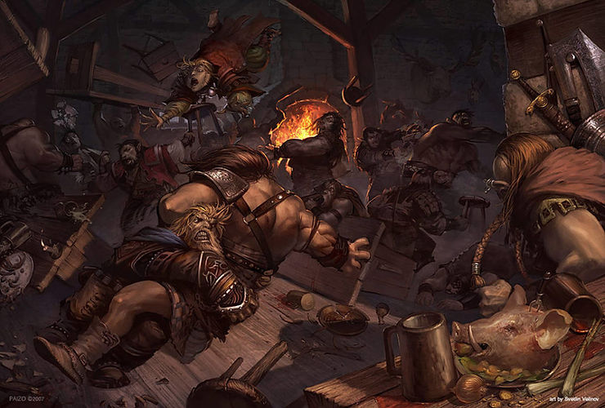
Intro: The Party that Fights Everything
You’ve carefully crafted a fun, multi-session mission for your adventuring party! There will be unknown wilds to explore; fearful monsters to be faced; puzzles to be solved; treasure to be found; villages to be saved. At the outset of the first session, you spread out your maps, ask everyone to position their tokens, and begin to narrate the start of this epic journey. The sun is setting, your player-characters have reached a cozy inn, you start to speak in character as the friendly innkeeper who will provide shelter and inform the party of a hidden evil nearby…
…aaaaaaand the rogue just picked his pocket, the wizard is challenging a random bar patron to a magic duel, and the barbarian decided it’s rage time and begins swinging their axe. *sigh*… roll initiative. What do you do next?

Slide 39
Dilemma 1a: Abusing the Dice Rolls
Your players are exploring a dark, unfamiliar cavern. You describe the atmosphere and layout in preparation for an intense exploration when suddenly:
“Can I roll to search the entire cave network?”
“Can I roll to blow up the cave?”
“I roll to find secret treasure.”
“Let’s roll every ten seconds to find traps!”
“I rolled a 20! What do I get?”
Players want to roll for everything, everywhere, all at once! How do you deal with the avalanche of dice?
a) Only allow rolls when you directly ask for them. Otherwise, dice should stay in their place!
b) Implement a system whereby each player can choose to roll for something on their own X times per session – perhaps 3 to 5.
c) Draw a distinction between “things the characters can just do,” and “things that require a roll.” You don’t need to roll to walk fifteen meters; you may need to roll to search a particular dark corner.
d) Every time the players make a roll without asking, do a roll of your own behind a screen. Shake your head ominously and say “That’s not good,” or “Hmmmm…” to create maximum panic.
e) Other _____________________________

Slide 40
Dilemma 2a: Everything is a joke
You’re excited to run a new campaign! Things start off well in the first two sessions, but starting in session three you notice a worrisome pattern. Every NPC you introduce gets assigned a silly nickname. Every town becomes an avenue for the player-characters to engage in drunken debauchery. You feel various potential narrative threads slipping away as more and more time is spent on random nonsense. Will your player characters ever engage with the world? What will you do next?
a) Take a look at your players’ backstories and see if you can find something to hook one or more of them in. Personal stakes should motivate them to engage more with the game.
b) Silly engagement is still engagement! Let the players have their fun. Keep putting plot threads out there, but if they don’t engage, help them expand their wacky escapades to even crazier heights.
c) Dark forces are brewing, whether the players want to engage with them or not. Set yourself an internal timer and after X sessions, a crisis erupts!!
d) Crank it up to 11 and throw them into a pure chaos dimension where everything is like a fever dream
e) Other _____________________________

Slide 41
Dilemma 3a: This encounter is too hard!!
Your players engage in fierce conflict with a dangerous opponent. Whether due to poor preparation, unsound tactics, simple bad luck, or a combination of the above, the encounter takes a turn for the worse. You had planned for a challenging encounter, but this looks much worse than even your worst-case scenario. The players turn grim-faced as their cherished characters face a brush with total doom. What do you do next?
a) Dial back the difficulty without them knowing. Whether it’s fudging the dice rolls, bringing in an unexpected ally, or making the enemy act irrational – throw your players a lifeline!
b) The dice tell the story, and it’s not up to us to interfere! Let things turn out as they may. If everyone needs to create new characters, so be it.
c) Encounters don’t have to end fatally – after defeating the party, the foe could imprison them, leading to new storylines.
d) Create an opening for the players to flee. All kinds of distractions can occur naturally, and if they choose to take advantage of it, more power to them – otherwise choose another option.
e) Other _____________________________

Slide 42
Dilemma 4a: Why can’t you be more like Matt Mercer?
a) Try to “upgrade” your campaign together in order to emulate everyone’s favorite online experiences. Pool a bit of money to get those new miniatures; assign everyone to find or create a piece of campaign-related art; write a new piece of lore for your setting and ask your players to expand on their backstories.
b) Gently remind your players that you are not a professional voice actor or roleplayer, and are instead a regular person with a life and concerns of your own. At the same time, make yourself open to constructive criticism. What are realistic areas for improvement as a DM? Request feedback from your players – and ask them to self-reflect as well.
c) Ask the player if they would be interested in running the campaign – or a side adventure – while you take a brief hiatus.
d) That’s it – rocks fall, everyone dies!!! NO ONE APPRECIATES MEEEE TIME TO POST ON REDDIT
e) Other _____________________________
Your campaign is in full swing and you’ve encountered an unexpected obstacle: one or more of your players are deeply invested in livestreamed RPGs, and constantly compares you to other DMs/GMs. “[Person A] created this awesome setting – why can’t our world be like this?” “Can we get new models and terrain for our encounters?” “Why don’t you do different voices for every NPC?” You’re beginning to feel frustrated and unappreciated. What do you do next?

